Slide 1
Today work
What is DFD?
What is sequence diagram?

Slide 2
What is DFD?
Data Flow Diagram (DFD) is a graphical representation of data flow in any system
Its illustrate
incoming data flow
outgoing data flow
store data.

Slide 3
Advantages of DFD
It helps us to understand the functioning and the limits of a system.
It is a graphical representation which is very easy to understand.
represent detailed and well explained diagram of system components.
It is used as the part of system documentation file.
can be understood by both technical or nontechnical person

Slide 4
Disadvantages of DFD
At times DFD can confuse the programmers regarding the system.
Data Flow Diagram takes long time to be generated, and many times due to this reasons analysts are denied permission to work on it.

Slide 5
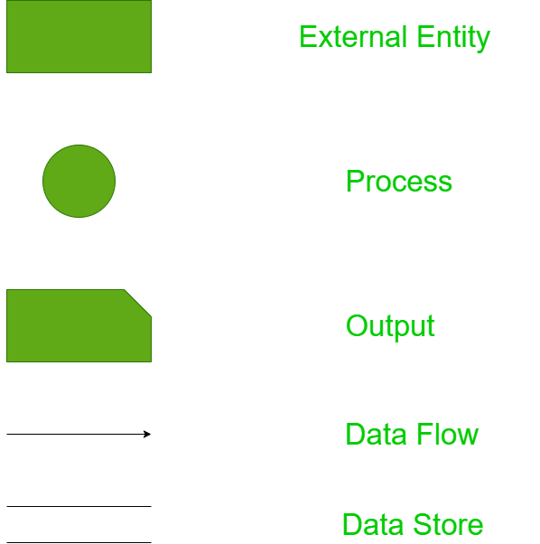
Components of Data Flow Diagram:

Slide 6
Components of Data Flow Diagram:
Entities:
Source of the data
Destination of the data
Entities are represented by rectangle.
Process:
The tasks performed on the data
Process is represented by circle.
Data Storage:
Data storage includes the database of the system
parallel lines.
Data Flow:
The movement of data in the system is known as data flow.
Represented with the help of arrow. The tail of the arrow is source and the head of the arrow is destination.

Slide 7
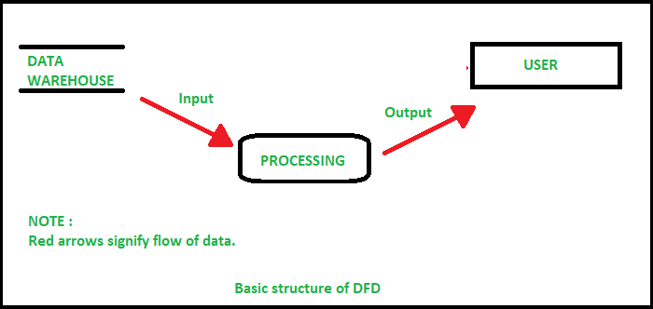
Components of Data Flow Diagram with example

Slide 8
Rules for creating DFD
The name of the entity should be easy and understandable
The processes should be numbered or put in ordered list
The DFD should maintain consistency across all the DFD levels.
A single DFD can have maximum processes upto 9 and minimum 3 processes

Slide 9
Levels of DFD
DFD uses hierarchy to maintain transparency thus multilevel DFD’s can be created.
Levels of DFD are as follows:
0-level DFD
1-level DFD:
2-level DFD:

Slide 10
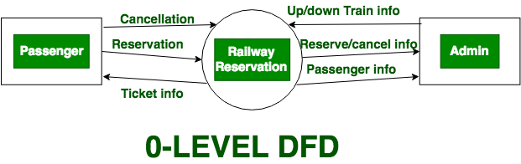
0-level DFD

Slide 11
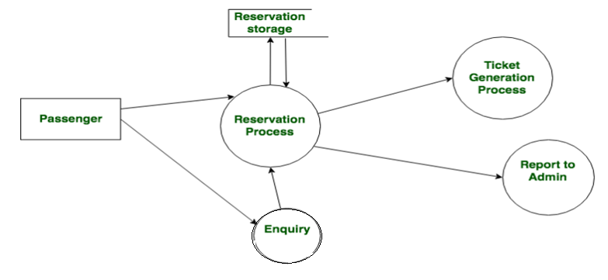
1-level DFD

Slide 12
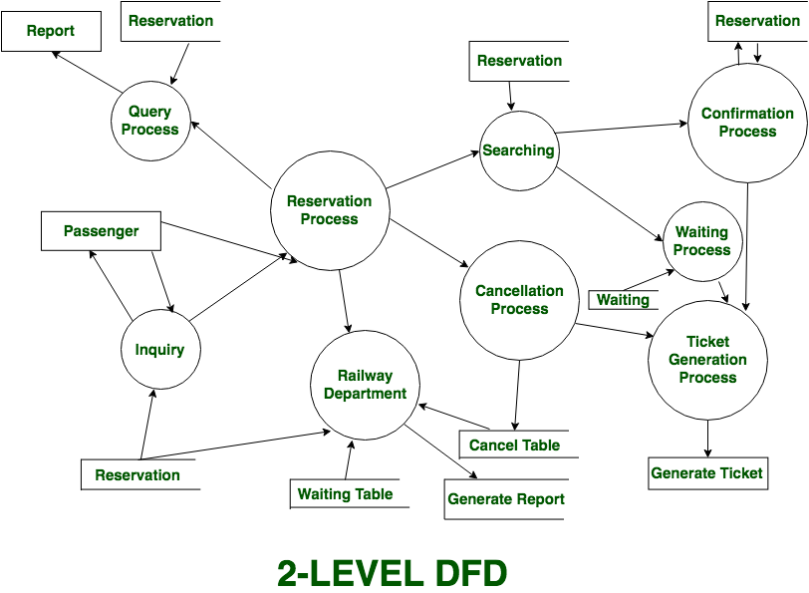
2-level DFD:

Slide 13
Rules for Data Flow Diagram
Data can not flow between two entities
Data can not flow between two data stores
Data can not flow directly from an entity to data store
A process must have at least one input data flow and one output data flow
A data store must have at least one input data flow and one output data flow
Two data flows can not cross each other.
All the process in the system must be linked to minimum one data store or any other process.

Slide 14
Sequence Diagram
How the object communicate?
What will be the sequence of message according to the time?

Slide 15
Elements
Actor
Objects
Life Line
Activation Time

Slide 16


Actor Objects Life Line Activation Time

Slide 17
Example : Sign up form
Lifelines
User
Page
Registration Form
Authentication Server

Slide 18
Steps
Click on Sign Up button
Open registration form
Enter user name
Check user name
User name does not exist
User name exists
Show warning about used user name
Enter password

Slide 19
Steps
Show invalid password message
Enter password confirmation
Show information about not matching passwords
Confirm the form
Create user
User successfully created
Redirect to success page

Slide 20
Example diagram shows
actor lifeline
four other lifelines
call messages
reply messages

Slide 21
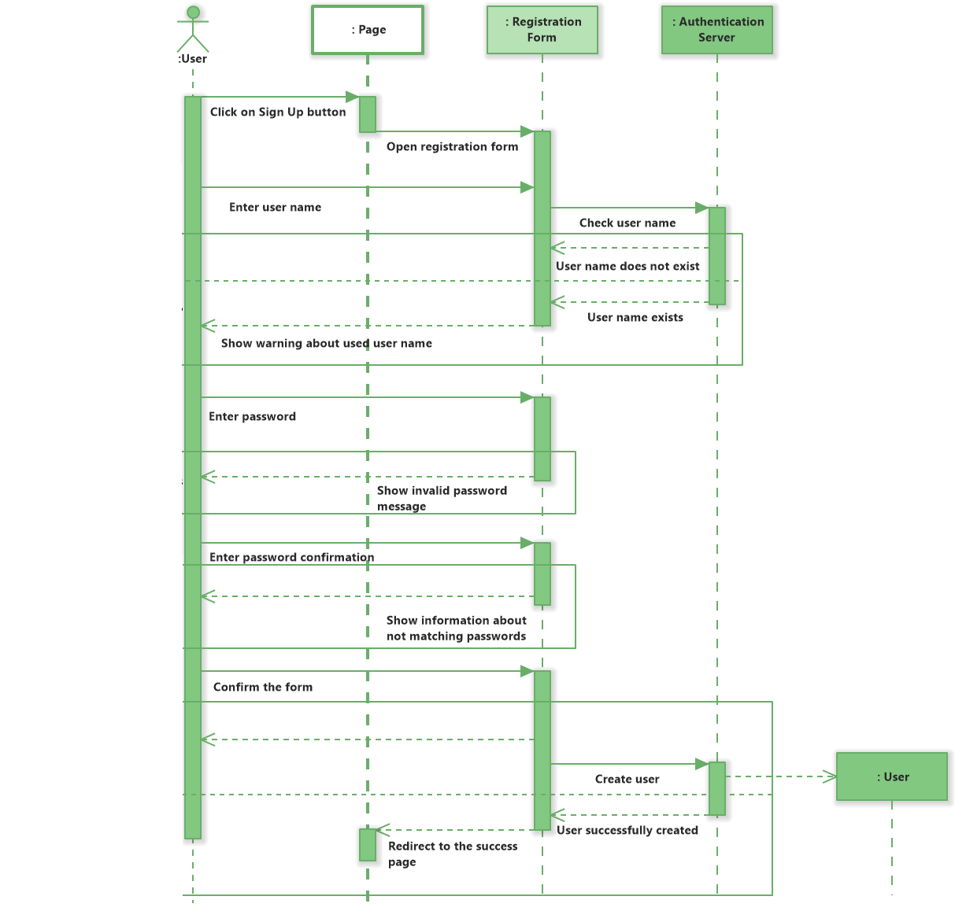

Slide 22
Thankyou

